Slide 1
Shared IT Services DevOps - Transformation
Notes:
[POC:Arun Ramachandran]

Slide 2

Agenda
Introduction
What is DevOps
Mission – DevOps Transformation
Q/A
Pilot high level scenario
Expectations
Pilot Projects

Slide 3

DevOps Team
Team member | Representing
Marcin Klimkiewicz | PM – SITS EMEA
Waldemar Jankowski | Development Platforms&Tools
Fryderyk Kajdzik | Runtime Practice Support (RPS)
Katarzyna Wojcik | VPS4IT
Rafal Likitarczuk | Project Practise Support (PPS)
Arun Ramachandran | Development Practises&Frameworks (DPaF)
DevOps !
Notes:
DevOps 80 sec video: https://youtu.be/baGHc04fMm0
A lengthy 7 min video: https://www.youtube.com/watch?v=_I94-tJlovg

Slide 4
What is DevOps ?
DevOps is the practice of operations
& development engineers participating
together in the entire service lifecycle,
from design through the development
process to production support.
Reduce Lead-time & Increase Quality
Developer and operations collaboration
Treating your code as an infrastructure
Automation of CI / CD to achieve the
goal of Continuous Delivery
A tool-chain approach
DevOps
Lean
&
Agile
Culture
Process
Automation
People
Technology

Slide 5
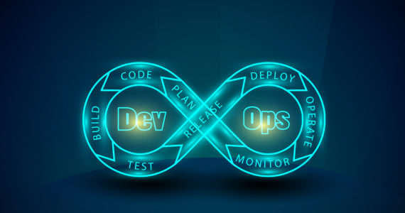
What is DevOps ?
DevOps is a cultural shift and collaboration (between development, operations and testing) and there is no single DevOps tool. It is rather a set (or "DevOps toolchain") consisting of multiple tools.
DevOps tools fit into one or more of the below categories which is reflective of key aspects of the software development and delivery process.

Slide 6

Mission: DevOps Pilot Transformation
To transform selected teams from regular Development practices to DevOps equipped method with the help of the external company Eficode. This would help us to produce quality artifacts for future transformation.
High level pilot approach
Pilot identification & buy in
Baseline and impact analysis
Build implementation plan
Start transformation projects

Slide 7
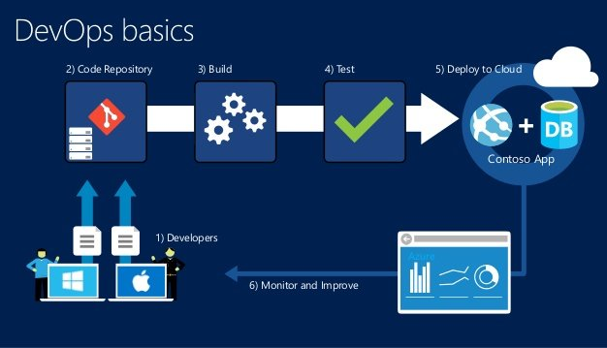
What Tools Are Used in DevOps
Source Code Repository
Build Server
Configuration Management
Virtual Infrastructure
Test Automation
Pipeline Orchestration

Slide 8
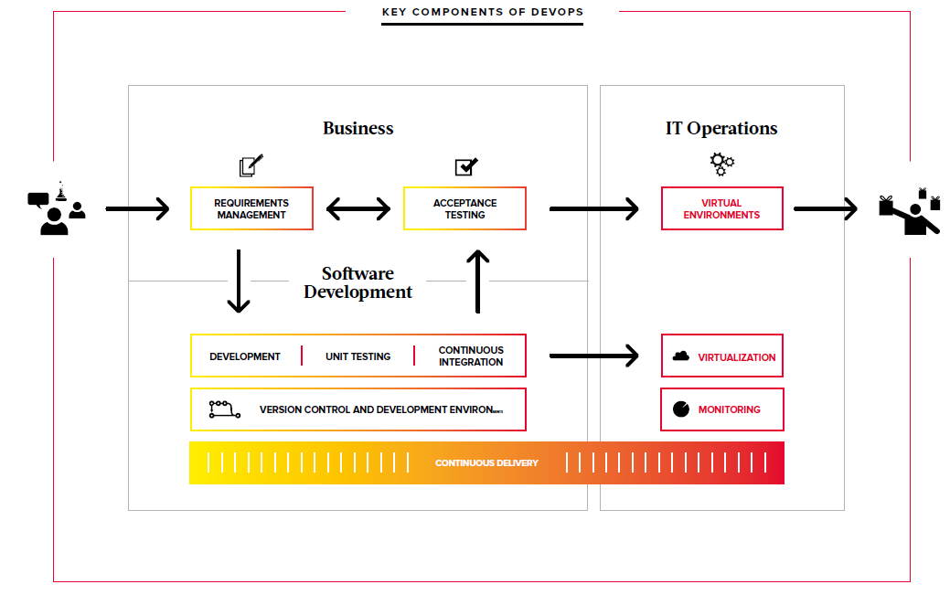
Key Components of DevOps by Eficode

Slide 9

DevOps Pilot scenario – Eficode work
1. Pilot team meeting
Team buy-in, agree on interviews and action plan
½-1 day, workshop, target team manager & team members
2. Perform interview & collect data
5 days, 5-7 persons interview + technical check, face to face
3. Build baseline and implementation plan
3 days, report on current state and prioritized roadmap
Presenting the plan for Volvo Group IT (project team, pilot team)
4. Decision: Go – No-Go
5. Start transformation project
Define governance model, roles and targets

Slide 10
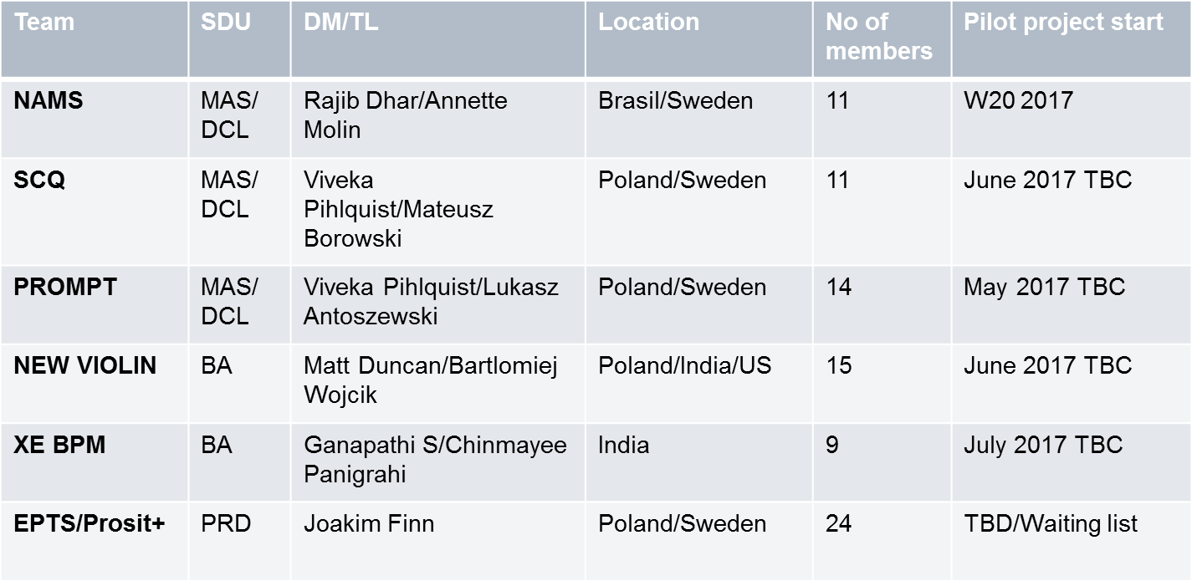
Who are the pilots ?
2017 target is to transform 5 teams and learn about DevOps as much as possible in order to be able to design and execute the change project for Volvo Group IT

Slide 11
Roles and responsibilities
Eficode | Pilot team | Project team
Driver role |  | Observer role
Will assess the team and propose the next steps | Will actively participate in the pilot transformation | Will monitor the pilot project and learn based on the observations
Will start and drive the transformation project according to the agreed scope | Will document the observations and share with the project team | Will support the pilot project if required (ex. administration, communication..)
Will document the findings and results as well as share with the project team | Will support in designing the implementation approach for the next teams | Will document the observations in order to produce the methodology for further concept roll out and and design the implementation approach

Slide 12

Next steps and targets for 2017
Kick off all agreed pilots and transform with the help of Eficode experts
Define best practice on continuous delivery pipeline Volvo Group IT
Understand the benefits and opportunities resulting from DevOps culture
Establish DevOps KPIs to be monitored on the Group IT level
Secure buy-in in Group IT organization via promotion of DevOps concept
Design and start the change project for further concept roll outs

Slide 13

Questions

Slide 14
Eficode with Project Team
Assess the state of the current DevOps implementation and identify areas for improvement.
What is the mission (team members were asked )
Focus on how to increase the product’s quality, enhance development and optimize development practices within the team.
The evaluation is based on Eficode’s maturity model which includes:
Devops maturity
Automation maturity
Test automation maturity
Background information of the project
How many members dev, test , Communication, location, roles defined, exp. Team restructure (sharing people between the project), along with Technical architecture, Short / Long (frequent ) meetings
Frist Dev – Test – Deployment local env. & the Ops
SCRUM, Waterfall, Agile Method – or combination of all 3 with VPS4 IT

Slide 15
Eficode with ProjectTeam
Reduce Lead-time & Increase Quality
Version Control
Branch & Merging strategy, Release Branch, Test & source code in same repo, what other CI’s present under VC tool.
How frequently pull the changes to get the updated changes from the repo.
Some of the code is not touched. Learn by breaking it
Continuous Integration
Is the CI set up running fine. Configured the automatic build & deployment but are you triggering it manually?
Nightly build, where the binaries are stored
Dedicated CI machine / server present
Testing
Sonarcube for code review, Sharing the reports with the business on the tasks delivered.
No. of automated test case execution
Release : Release cycle (3 months ?) Pushing the deadlines for any releases, UAT Phase 2 weeks ?

